Slide 1


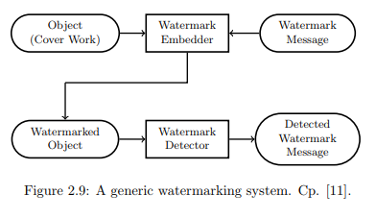
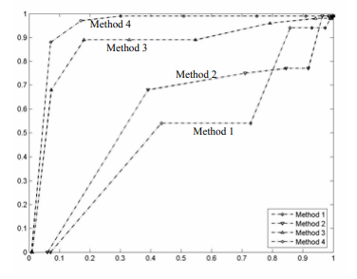
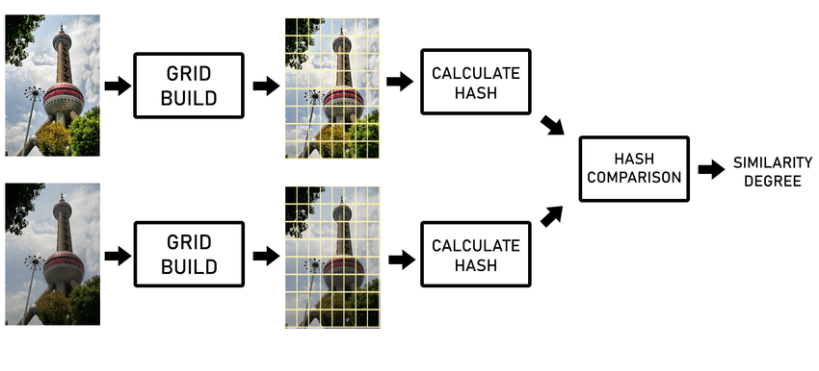
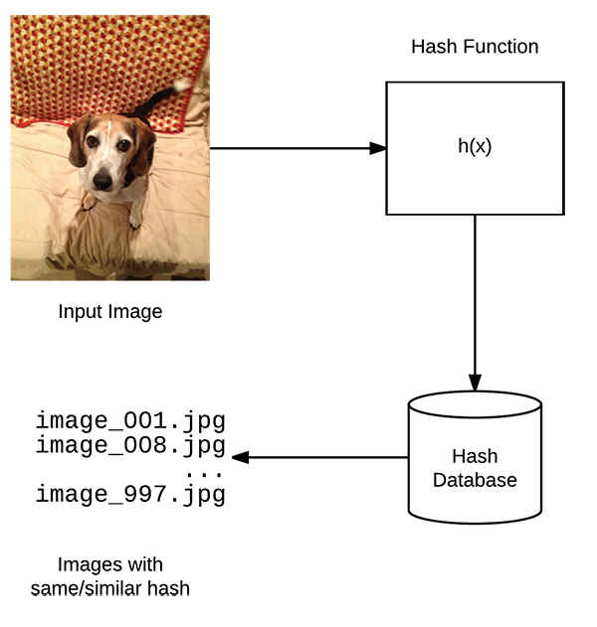
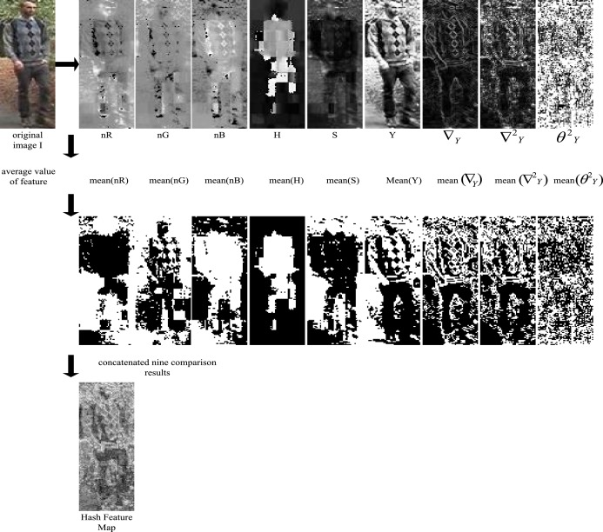
Perceptual Image Hashing Algorithms in CUDA
Ha Hwang, Wasfi Momen
Department of Computer Science, Georgia State University
dHash:
Convert the image to grayscale
Downsize it to a 9x9 thumbnail (size=8 means an 8+1 by 8+1 image)
Produce a 64-bit “row hash”: a 1 bit means the pixel intensity is increasing in the x direction, 0 means it’s decreasing
Do the same to produce a 64-bit “column hash” in the y direction
Combine the two values to produce the final 128-bit hash value
Block-based means::
a) Convert the image to grey scale and normalize the original image intoa preset size.
b) LetNdenote the bit length (e.g. 256 bit) of the final hash value. Di-vide the pixels of the imageIinto non-overlapped blocksI1,I2,...,IN.
c) Encrypt the indices of the block sequence{I1,I2,...,IN}using a se-cret keyKto obtain a block sequence with a new scanning order{I′1,I′2,...,I′N}. [44] specifies no further details about what encryp-tion algorithm to use. So it is up to the implementor of this perceptualimage hash function to choose an adequate one.
d) Calculate the mean of the pixel values of each block. That is, calculatethe mean value sequence{M1,M2,...,MN}from corresponding blocksequence{I′1,I′2,...,I′N}. Finally obtain the median valueMdof themean value sequence.
e) Normalize the mean value sequence into a binary form and obtain thehash valuehash(i) ={0,Mi< Md1,Mi≥Md
For the graph:
method 1 is above blocked based means
method 2 is using overlapping blocks
method 3 is preventing rotation attacks by rotating output matrices by degrees
method 4 is is 2 and 3 combined
Graph is receiver operating characteristic (ROC curve) depicting x-axis as the False Recognition Rate (false recognitions / # of identification attempts) and y-zxis as the False Acceptance Rate (false acceptances / # of identification attempts) as a binary classifer.
BACKGROUND
PROBLEM
Tracking images based on content provides unique challenges for social media applications, copyright protection divisions, and image aggregator sites.
Perceptual Image Hashing attempts to create a hash based on features and compare to similar hashes to find similar images.
These hashes are not cryptographic where small changes to input result in large changes to the output. Instead, changes to image input result in similar images and thus the hash output should not drastically change.
For this project, we aim to implement two known perceptual image hashing algorithms block-based means hash and dHash in CUDA to provide significant computational speedup to the sequential algorithms built in pHash.
Computation is slow in cpu for highly accurate perceptual image hash algorithms. Parallelization is important in order to achieve speedup.
OBJECTIVES
Implement block-based means hash
Implement dHash in Cuda
Compare sequential and parallel algorithms to find speedup factor
RESULTS
Sources
B. Yang, F. Gu and X. Niu, "Block Mean Value Based Image Perceptual Hashing," 2006 International Conference on Intelligent Information Hiding and Multimedia, Pasadena, CA, USA, 2006, pp. 167-172.
C. Zauner, “Implementation and Benchmarking of Perceptual Image Hash Functions,” Thesis, Hagenberg, Austria, 2010.
N. Krawetz, “Looks Like It - The Hacker Factor Blog,” [online] Hackerfactor.com. Available at: http://hackerfactor.com/blog/index.php%3F/archives/432-Looks-Like-It.html [Accessed 25 Apr. 2019].
To be determined
It is hoped that parallel block-based implementation of perceptual image hashing would result in faster execution time than sequential algorithm.
PERCEPTUAL HASHING-BASED AUTHENTICATION
dHash looks at the luminance value of the pixel left of it and sets the value of the current pixel to 0 or 1 if it is brighter or darker. These row sets are combined to make a 128 bit hash value .
Block-based means hashing takes the mean of pixel values per block of the image. Each block was encrypted with a secret key. Similar to dHash, the mean pixel values are normalized to 0 or 1 based on if the mean pixel value is smaller or larger than the median value pixel.
CSC 8530 Dr. Rolando Estrada Spring 2019 Parallel Algorithms

